Slide 1
Battleship Game Design Document

Slide 2
Requirement
Functional
Non-functional

Slide 3
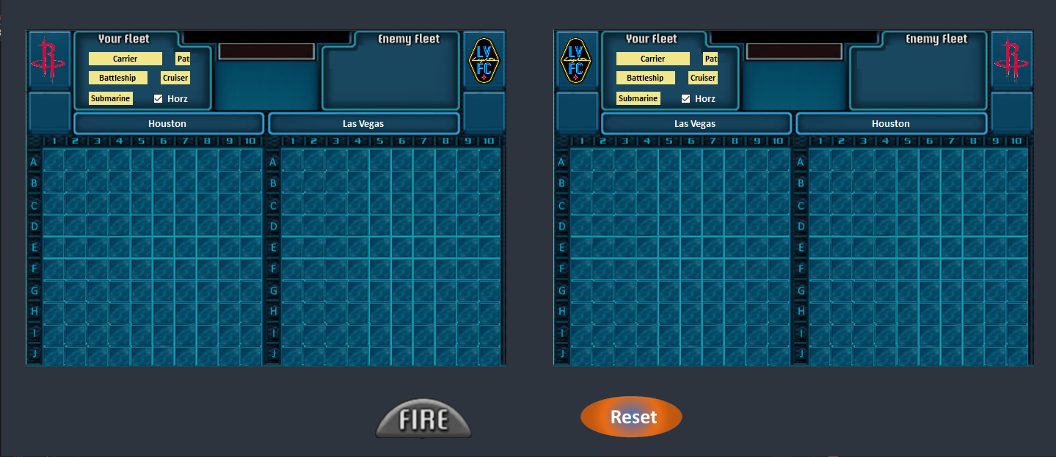
UX Design

Slide 4
Architecture View
updates (event)
Battleship View
Battleship Controller
uses
updates
(event)
manipulates
Battleship Model

Slide 5
Class Diagram & Sequence Diagram
TBD

Slide 6
Deployment View
<<dll>>
Battleship Controller
Battleship UI
<<exe>>
Battleship Model
<<dll>>

Slide 7
Architecture Concerns - Extensibility
The architecture has taken future extensibility into account
The size of the board can configurable
The size of the ships can be configurable
we can add more battle ships
File based or database based storage system can be introduced to save current state, result, and user settings.

Slide 8
Architecture Concerns - Extensibility
Most likely, this app will needs to be extended for remote playing. The following diagram is an example.
Battleship UI
Computer 1
Computer 2
Battleship UI
Battleship Model
Mosquitto MQTT Broker
Mosquitto MQTT Broker
Battleship Model
Topic

Slide 9
Architecture Concerns - Extensibility
AI
We can use BFS to find the seed of ship
Once we find a ship, we can use DFS to finish current ship

Slide 10
Architecture Concerns - Maintainability
The MVC architecture pattern ensures the software’s Maintainability
Designed against the interface, the concrete class should be easy to change

Slide 11
Architecture Concerns - Diagnosable
The architecture utilized Nlog as logger.
Major user events has been logged
Major business logic event has been logged
Error has been logged

Slide 12
Architecture Concerns - Portability
This app intentionally selects .Net Framework 4.5 so that it should be compatible with majority of the Windows systems
The app should be easy to be deployed, e.g. with zip package

